Slide 1
SENG 1000 - Software Engineering Foundations and Practice
-Sumati

Slide 2
Topics
Introduction to Functions
Defining and Calling a Function
Designing a Program to Use Functions
Local Variables
Passing Arguments to Functions
Global Variables and Global Constants

Slide 3
Introduction to Functions
Function: group of statements within a program that perform as specific task
Usually one task of a large program
Functions can be executed in order to perform overall program task
Known as divide and conquer approach
Modularized program: program wherein each task within the program is in its own function

Slide 4
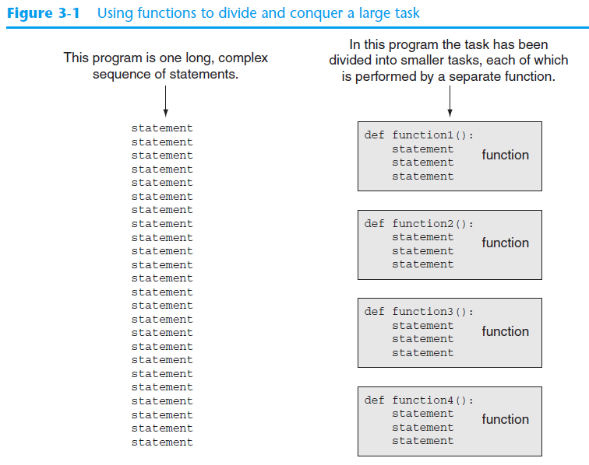
Using Functions to divide and conquer

Slide 5
Benefits of Modularizing a Program with Functions
The benefits of using functions include:
Simpler code
Code reuse
write the code once and call it multiple times
Better testing and debugging
Can test and debug each function individually
Faster development
Easier facilitation of teamwork
Different team members can write different functions

Slide 6
Defining and Calling a Function
Functions are given names
Function naming rules:
Cannot use key words as a function name
Cannot contain spaces
First character must be a letter or underscore
All other characters must be a letter, number or underscore
Uppercase and lowercase characters are distinct

Slide 7
Defining and Calling a Function (cont’d.)
Function name should be descriptive of the task carried out by the function
Often includes a verb
Function definition: specifies what function does
def function_name() :
statement
statement

Slide 8
Defining and Calling a Function (cont’d.)
Function header: first line of function
Includes keyword def and function name, followed by parentheses and colon
Block: set of statements that belong together as a group
Example: the statements included in a function

Slide 9
Defining and Calling a Function (cont’d.)
Call a function to execute it
When a function is called:
Interpreter jumps to the function and executes statements in the block
Interpreter jumps back to part of program that called the function
Known as function return

Slide 10
Defining and Calling a Function (cont’d.)
main function: called when the program starts
Calls other functions when they are needed
Defines the mainline logic of the program

Slide 11
Indentation in Python
Each block must be indented
Lines in block must begin with the same number of spaces
Use tabs or spaces to indent lines in a block, but not both as this can confuse the Python interpreter
IDLE automatically indents the lines in a block
Blank lines that appear in a block are ignored

Slide 12
Designing a Program to Use Functions
In a flowchart, function call shown as rectangle with vertical bars at each side
Function name written in the symbol
Typically draw separate flow chart for each function in the program
End terminal symbol usually reads Return
Top-down design: technique for breaking algorithm into functions

Slide 13
Designing a Program to Use Functions (cont’d.)
Hierarchy chart: depicts relationship between functions
AKA structure chart
Box for each function in the program, Lines connecting boxes illustrate the functions called by each function
Does not show steps taken inside a function
Use input function to have program wait for user to press enter

Slide 14
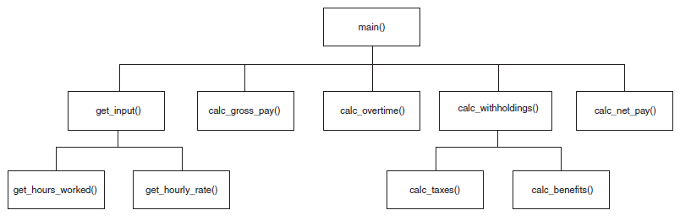
A hierarchy chart

Slide 15
Local Variables
Local variable: variable that is assigned a value inside a function
Belongs to the function in which it was created
Only statements inside that function can access it, error will occur if another function tries to access the variable
Scope: the part of a program in which a variable may be accessed
For local variable: function in which created

Slide 16
Local Variables (cont’d.)
Local variable cannot be accessed by statements inside its function which precede its creation
Different functions may have local variables with the same name
Each function does not see the other function’s local variables, so no confusion

Slide 17
Passing Arguments to Functions
Argument: piece of data that is sent into a function
Function can use argument in calculations
When calling the function, the argument is placed in parentheses following the function name

Slide 18
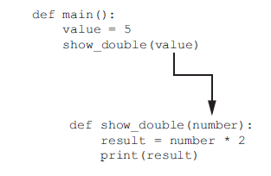
Passing Arguments to Functions (cont’d.)
Value variable is passed as an argument

Slide 19
Passing Arguments to Functions (cont’d.)
Parameter variable: variable that is assigned the value of an argument when the function is called
The parameter and the argument reference the same value
General format:
def function_name(parameter) :
Scope of a parameter: the function in which the parameter is used

Slide 20
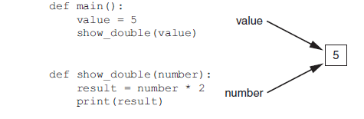
Passing Arguments to Functions (cont’d.)
Value variable and the number parameter reference the same value

Slide 21
Passing Multiple Arguments
Python allows writing a function that accepts multiple arguments
Parameter list replaces single parameter
Parameter list items separated by comma
Arguments are passed by position to corresponding parameters
First parameter receives value of first argument, second parameter receives value of second argument, etc.

Slide 22
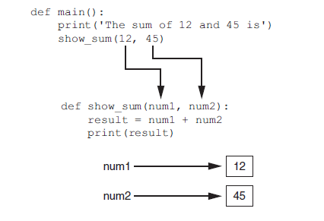
Passing Multiple Arguments (cont’d.)

Slide 23
Making Changes to Parameters
Changes made to a parameter value within the function do not affect the argument
Known as pass by value
Provides a way for unidirectional communication between one function and another function
Calling function can communicate with called function

Slide 24
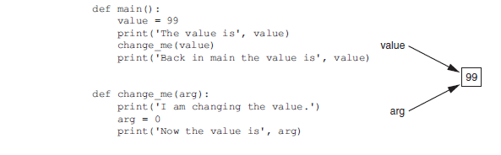
Making Changes to Parameters (cont’d.)

Slide 25
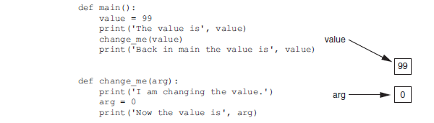
Making Changes to Parameters (cont’d.)
The value variable passed to the change_me function cannot be changed by it

Slide 26
Keyword Arguments
Keyword argument: argument that specifies which parameter the value should be passed to
Position when calling function is irrelevant
General Format:
function_name(parameter=value)
Possible to mix keyword and positional arguments when calling a function
Positional arguments must appear first

Slide 27
Global Variables and Global Constants
Global variable: created by assignment statement written outside all the functions
Can be accessed by any statement in the program file, including from within a function
If a function needs to assign a value to the global variable, the global variable must be redeclared within the function
General format: global variable_name

Slide 28
Global Variables and Global Constants (cont’d.)
Reasons to avoid using global variables:
Global variables making debugging difficult
Many locations in the code could be causing a wrong variable value
Functions that use global variables are usually dependent on those variables
Makes function hard to transfer to another program
Global variables make a program hard to understand

Slide 29
Global Constants
Global constant: global name that references a value that cannot be changed
Permissible to use global constants in a program
To simulate global constant in Python, create global variable and do not re-declare it within functions

